Slide 1
Web Crawling - UBike
0856706 Susan Ku

Slide 2
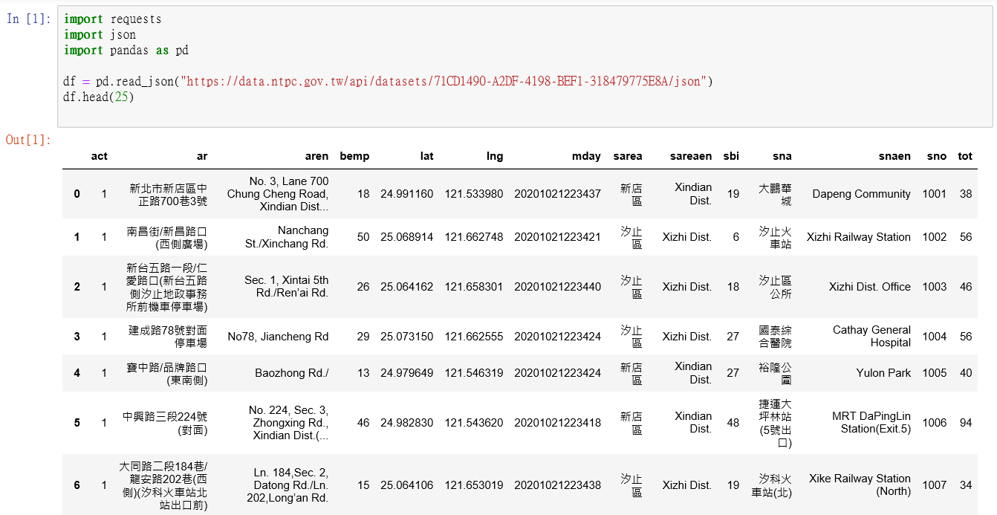
Web Crawling (for Ubike)
For better visualization on the output data, using pandas to read the json file

Slide 3
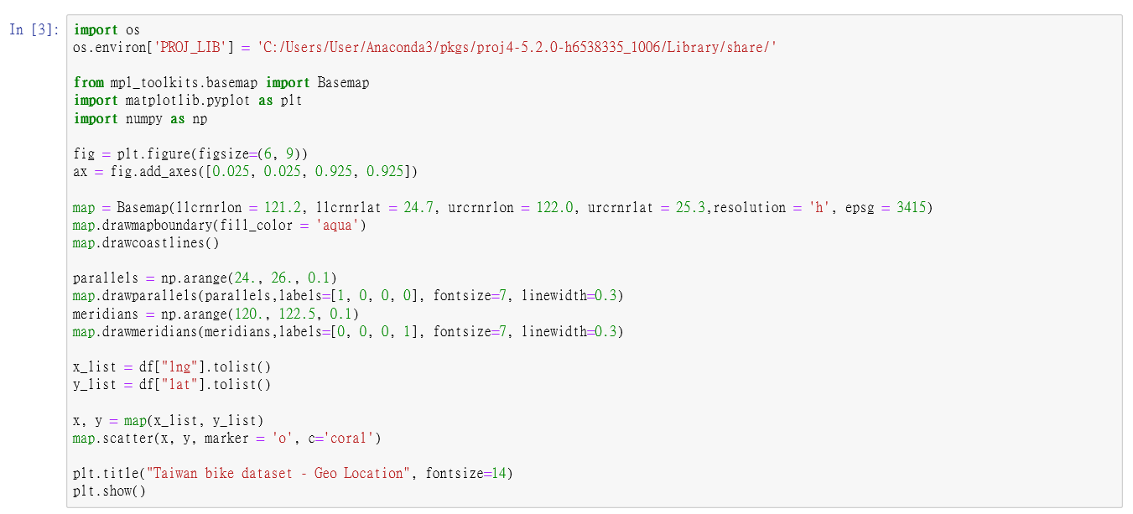
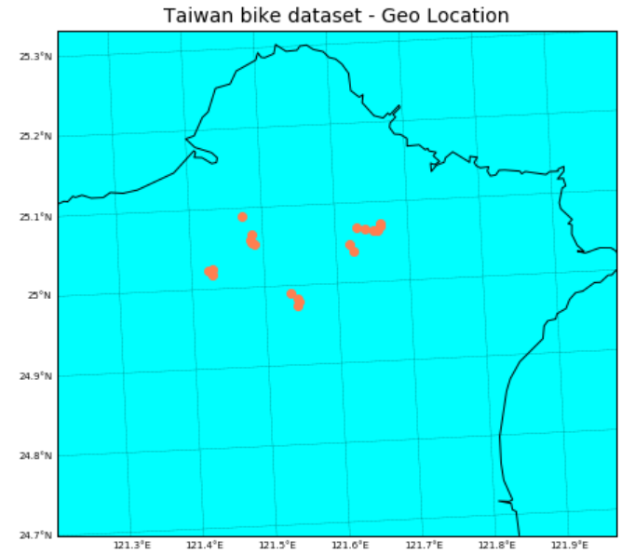
Scatter Plot (1)
Show GEO information to see which area riding UBike more

Slide 4
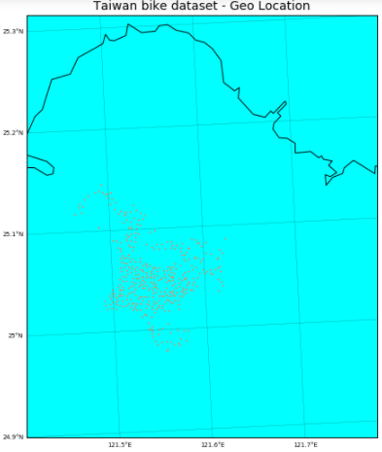
Scatter Plot (2)
Read more open data from:
https://tcgbusfs.blob.core.windows.net/blobyoubike/YouBikeTP.json

